Slide 1
Software Architecture and Design

Slide 2
What is Software Architecture

Slide 3
Definitions
The software architecture of a program or computing system is the structure or structures of the system which comprise
  The software components
  The externally visible properties of those components
  The relationships among the components

Slide 4
Architecture defined
Formal Definition
IEEE 1471-2000
  Software architecture is the fundamental organization of a system, embodied in its components, their relationships to each other and the environment, and the principles governing its design and evolution.
Notes:
.
Emphasize that the rationale for the architectural decisions is very important.

Slide 5
Architecture defined
Software architecture encompasses the set of significant decisions about the organization of a software system
  Selection of the structural elements and their interfaces by which a system is composed
  Behavior as specified in collaborations among those elements
  Composition of these structural and behavioral elements into larger subsystems
  Architectural style that guides this organization
Notes:
.
Emphasize that the rationale for the architectural decisions is very important.

Slide 6
Architecture defined
Perry and Wolf, 1992
  A set of architectural (or design) elements that have a particular form
Boehm et al., 1995
  A software system architecture comprises
    A collection of software and system components, connections, and constraints
    A collection of system stakeholders' need statements
    A foundation which demonstrates that the components, connections, and constraints define a system that, if implemented, would satisfy the collection of system stakeholders' need statements
Notes:
.
Key words in the definitions are underlined.

Slide 7
Architecture defined
Architecture is not a single structure -- no single structure is the architecture
Notes:
.
Every system has an architecture, even if it is not formally “spec’ed out”.

Slide 8
Architecture is Early
Architecture represents the set of earliest design decisions
  Hardest to change
  Most critical to get right
Architecture is the first design artifact where a system’s quality attributes are addressed

Slide 9
Architecture Drives
Architecture serves as the blueprint for the system but also the project:
  Team structure
  Documentation organization
  Work breakdown structure
  Scheduling, planning, budgeting
  Unit testing, integration
Architecture establishes the communication and coordination mechanisms among components

Slide 10
Architecture vs. Design

Slide 11
Architecture vs. Design
Architecture: where non-functional decisions are cast, and functional requirements are partitioned
Design: where functional requirements are accomplished
architecture
non-functional requirements
design
functional requirements
Important : this is a general guideline – sometimes the borders are blurred
Notes:
.

Slide 12

System Quality Attribute
Performance
Availability
Usability
Security
Time To Market
Cost and Benefits
Projected life time
Targeted Market
Integration with Legacy System
Roll back Schedule
End User’s view
Business
Community
view
Maintainability
Portability
Reusability
Testability
Developer’s view
A list of quality attributes exists in
ISO/IEC 9126-2001 Information Technology – Software Product Quality
Notes:
.
We will return to this when we’ll speak about Evaluating Architectures (ATAM, LAAAM)

Slide 13
Typical Descriptions of
Software Architectures
  "Camelot is based on the client-server model and uses remote procedure calls both locally and remotely to provide communication among applications and servers." [Spector 87]
  "We have chosen a distributed, object-oriented approach to managing information." [Linton 87]
  "The easiest way to make the canonical sequential compiler into a concurrent compiler is to pipeline the execution of the compiler phases over a number of processors." [Seshadri 88]
  "The ARC network [follows] the general network architecture specified by the ISO in the Open Systems Interconnection Reference Model." [Paulk 85]

Slide 14
Architectural Design Level of Software
Deals with the composition of software systems from module-scale elements
  Gross decomposition of required function
    What patterns of organization are useful?
    Which organization fits the application best?
  Assignment of function to design elements
    What are the elements?
    How do the elements interact?
  Emergent system properties
    Scaling and performance: Capacities, balance, schedules
    Security
    ...
  Selection among design alternatives
    Which implementations of elements will work best?

Slide 15
Architectural Design Task
Issues for architecture and programs differ
  Architecture Programs
  interactions among parts implementations of parts
  structural properties computational properties
  declarative operational
  mostly static mostly dynamic
  system-level performance algorithmic performance
  outside module boundary inside module boundary
  composition of subsystems copy code or call libraries

Slide 16
Promised Benefits of
Architectural Modeling
Clarify design intentions
  Intended architecture is often lost. It's mostly informal, it's hard to communicate anyhow.
Provide basis for analysis in design
  Engineering design entails performance prediction and design tuning. Routine practice.
Improve maintenance
  Over half of maintenance effort goes into figuring out just what's there.
Address the hard questions
  Even without formal methods, explicit architectural modelling can uncover fuzzy requirements, thinking, and design approaches

Slide 17
Promised Benefits of
Architectural Modeling
update document (6%)
review document
(6%)
test & debug (28%)
define/analyze change
Requirements
(18%)
Architecture
trace logic
(23%)
Design
implement change (19%)
Reduce maintenance
costs, directly and
indirectly
Code/Integ
Clarify intentions
Make decisions and implications explicit
Permit system-level analysis
Test/Accept
Maintenance

Slide 18
Architectural Design Reviews
Prospectus
Planning and
Architecture Phase
Requirements
Discovery
Review
Architecture
High-Level
Design
Source:
Joe Maranzano
ATT Bell Labs
Architecture
Review
Low-Level
Design

Slide 19
Architectural Structure:
Components, Connectors, Systems
Components
  computational elements
Ports
  interface points for components
Connectors
  interactions between components
Roles
  interface points for connectors
Systems
  graphs of component and connectors

Slide 20
Architectural Design Process
System structuring
  system decomposed into several subsystems
  subsystem communication is established
Control modeling
  model of control relationships among system components is established
Modular decomposition
  identified subsystems decomposed into modules

Slide 21
Architectural Models
Static structural model
  shows major system components
Dynamic process model
  shows process structure of the system
Interface model
  defines subsystem interfaces
Relationships model
  data flow or control flow diagrams

Slide 22
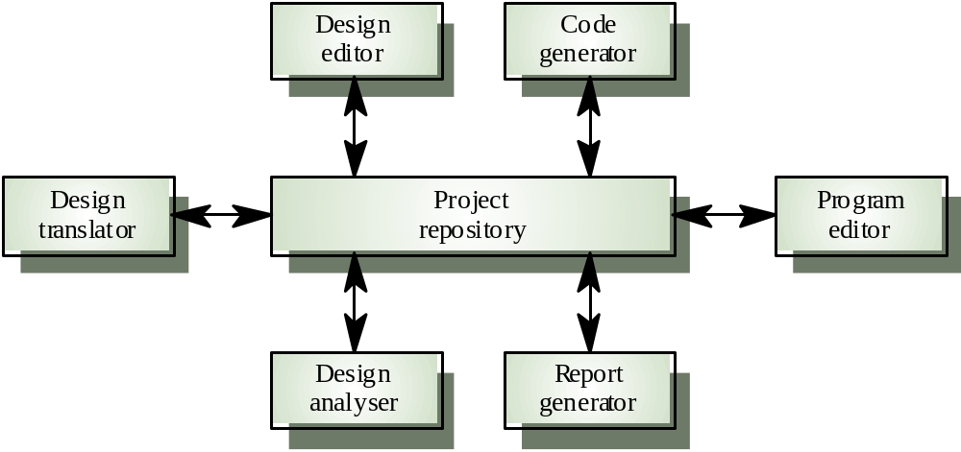
CASE Repository Model

Slide 23
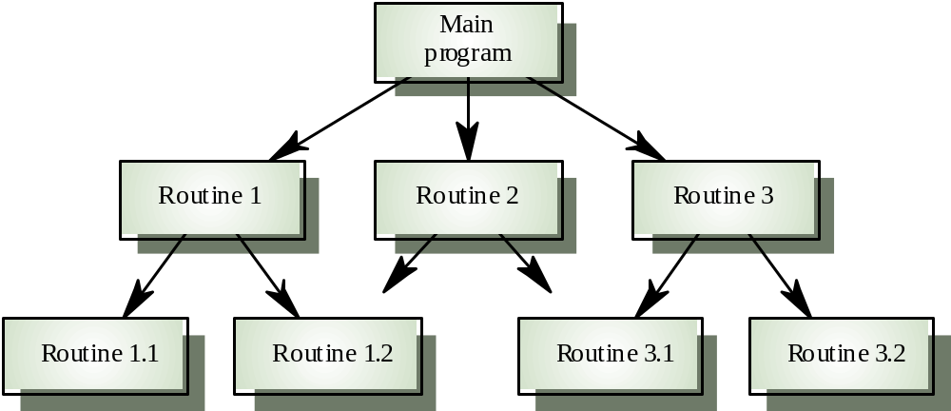
Call-Return Model

Slide 24
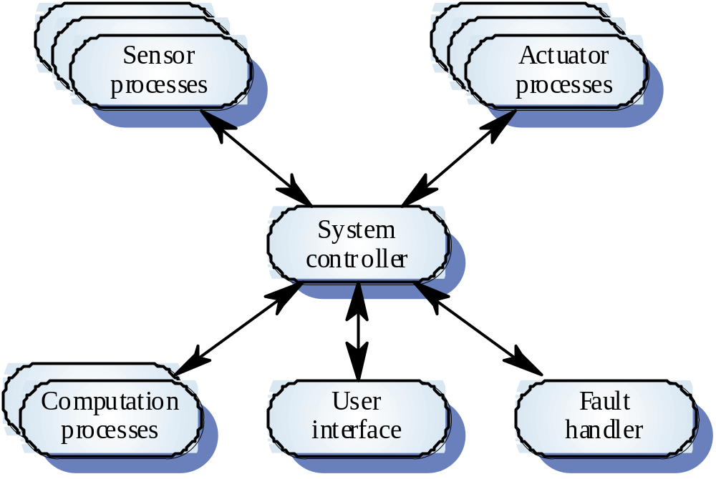
Real-Time System Control Model

Slide 25
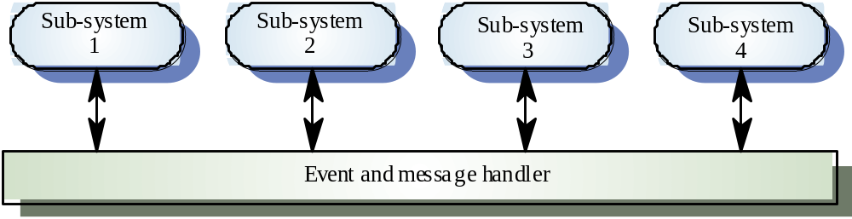
Selective Broadcasting Model

Slide 26
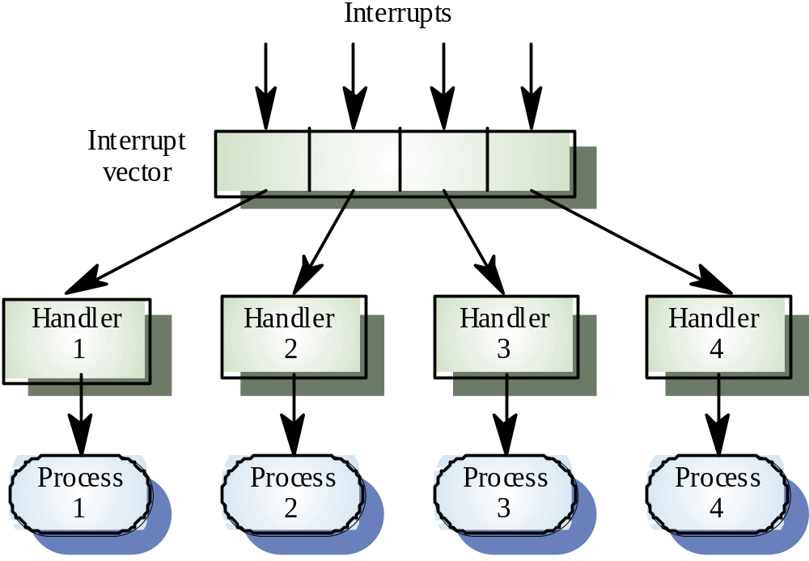
Interrupt-Driven Control Model

Slide 27
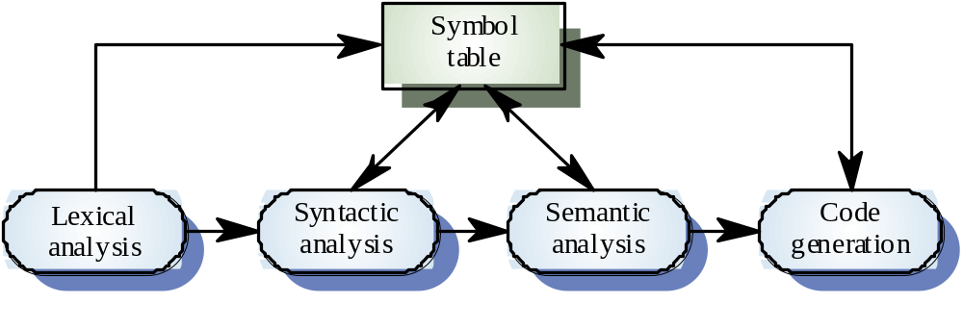
Compiler Model

Slide 28
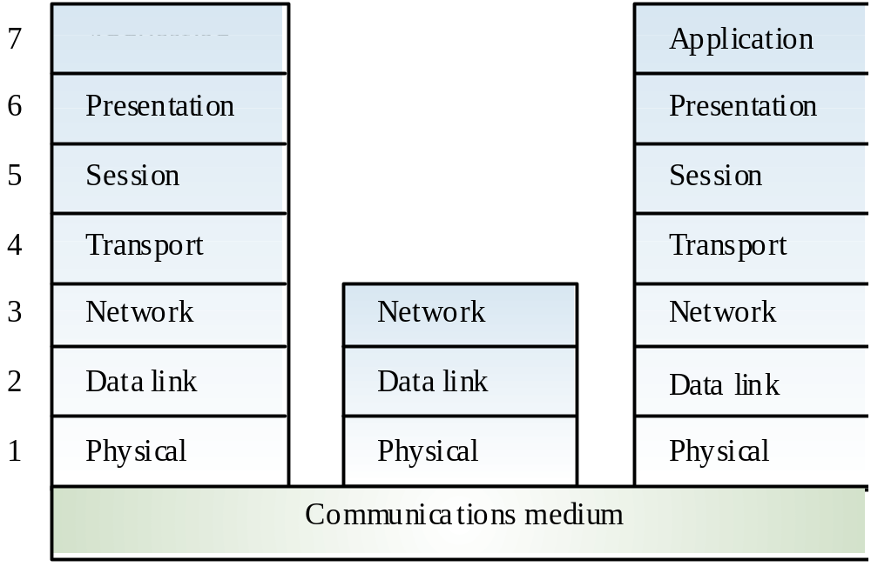
OSI Reference Model
Application

Slide 29
Distributed Systems
Most large computer systems are implemented as distributed systems
Information is also distributed over several computers rather than being confined to a single machine
Distributed software engineering has become very important

Slide 30
Distributed Systems Architectures
Client/Server
  offer distributed services which may be called by clients
  servers providing services are treated differently than clients using the services
Distributed Object
  no distinctions made between clients and servers
  any system object may provide and use services from any other system object

Slide 31
Middleware
Software that manages and supports the different components of a distributes system
Sits in the middle of the system to broker service requests among components
Usually off-the-shelf products rather than custom
Representative architectures
  CORBA (ORB)
  COM (Microsoft)
  JavaBeans (Sun)

Slide 32
Multiprocessor Architecture
Simplest distributed system model
System composed of multiple processes that may execute on different processors
Model used in many large real-time systems
Distribution of processes to processors may be preordered or may be under control of a dispatcher

Slide 33
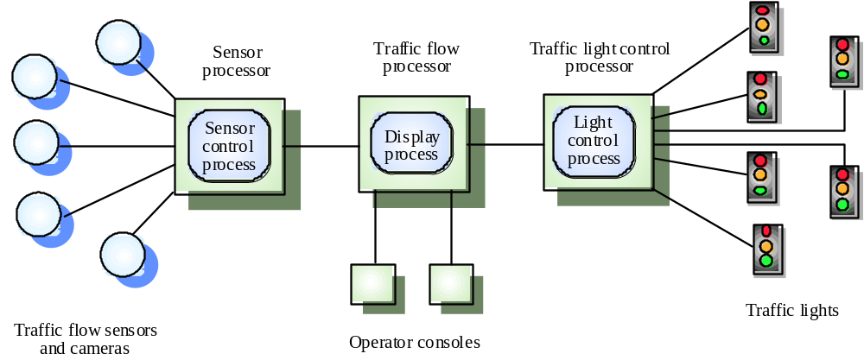
Multiprocessor Traffic Control System

Slide 34
Client/Server Architectures
Application is modeled as a set of services that are provided by servers and a set of clients that use these services
Clients know the servers but the servers do not need to know all the clients
Clients and servers are logical processes (not always physical machines)
The mapping of processes to processors is not always 1:1

Slide 35
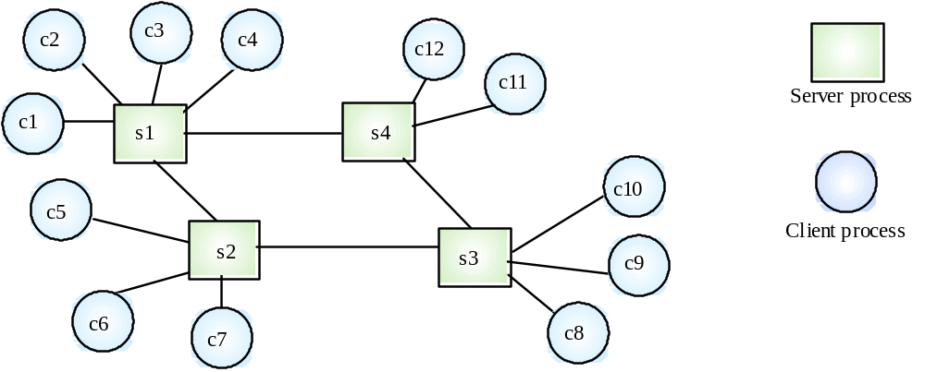
Client/Server System

Slide 36
Representative Client/Server Systems
File servers
  client requests selected records from a file
  server transmits records to client over the network
Database servers
  client sends SQL requests to server
  server processes the request
  server returns the results to the client over the network

Slide 37
Representative Client/Server Systems
Transaction servers
  client sends requests that invokes remote procedures on the server side
  server executes procedures invoked and returns the results to the client
Groupware servers
  server provides set of applications that enable communication among clients using text, images, bulletin boards, video, etc.

Slide 38
Client/Server Software Components
User interaction/presentation subsystem
Application subsystem
  implements requirements defined by the application within the context of the operating environment
  components may reside on either client or server side
Database management subsystem
Middleware
  all software components that exist on both the client and the server to allow exchange of information

Slide 39
Thin Client Model
Used when legacy systems are migrated to client server architectures
  the legacy system may act as a server in its own right
  the GUI may be implemented on a client
It chief disadvantage is that it places a heavy processing load on both the server and the network

Slide 40
Fat Client Model
More processing is delegated to the client as the application processing is locally extended
Suitable for new client/server systems when the client system capabilities are known in advance
More complex than thin client model with respect to management issues
New versions of each application need to installed on every client

Slide 41
Three-tier Architecture
Each application architecture layers (presentation, application, database) may run on separate processors
Allows for better performance than a thin-client approach
Simpler to manage than fat client approach
Highly scalable (as demands increase add more servers)

Slide 42
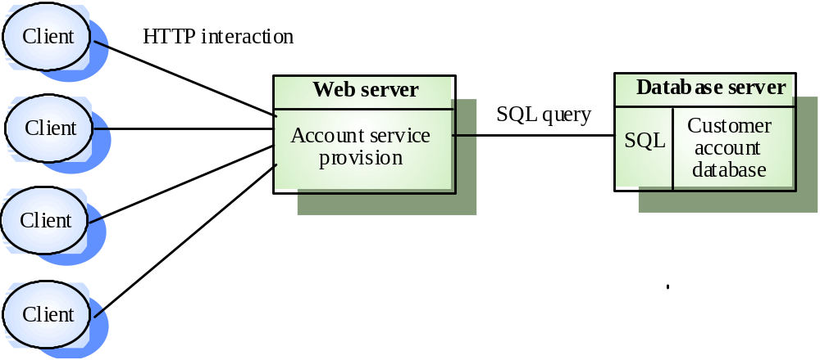
Three-Tier Architecture

Slide 43
Design Issues for Client/Server Systems
Data and architectural design
  dominates the design process to be able to effectively use the capabilities of RDBMS or OODMBS
Event-driven paradigm
  when used, behavioral modeling should be conducted
  the control-oriented aspects of the behavioral model should translated into the design model

Slide 44
Design Issues for Client/Server Systems
Interface design
  elevated in importance
  user interaction/presentation component implements all functions associated with a GUI
Object-oriented point of view
  often chosen, since object structure is provided by events initiated in the GUI and their event handlers within the client-based software

Slide 45
Distributed Object Architectures
No distinctions made between client objects and server objects
Each distributable entity is an object that both provides and consumes services
Object communication is though an object request broker (middleware or software bus)
More complex to design than client/server systems

Slide 46
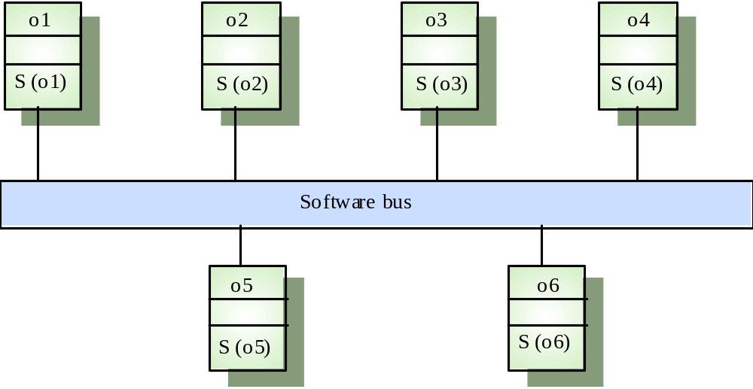
Distributed Object Architecture from Sommerville

Slide 47
Architectural Design Process
Basic Steps
  Creation of the data design
  Derivation of one or more representations of the architectural structure of the system
  Analysis of alternative architectural styles to choose the one best suited to customer requirements and quality attributes
  Elaboration of the architecture based on the selected architectural style
A database designer creates the data architecture for a system to represent the data components
A system architect selects an appropriate architectural style derived during system engineering and software requirements analysis

Slide 48
Emphasis on Software Components
A software architecture enables a software engineer to
  Analyze the effectiveness of the design in meeting its stated requirements
  Consider architectural alternatives at a stage when making design changes is still relatively easy
  Reduce the risks associated with the construction of the software
Focus is placed on the software component
  A program module
  An object-oriented class
  A database
  Middleware

Slide 49
Software Architectural Styles

Slide 50
Software Architectural Style
The software that is built for computer-based systems exhibit one of many architectural styles
Each style describes a system category that encompasses
  A set of component types that perform a function required by the system
  A set of connectors (subroutine call, remote procedure call, data stream, socket) that enable communication, coordination, and cooperation among components
  Semantic constraints that define how components can be integrated to form the system
  A topological layout of the components indicating their runtime interrelationships

Slide 51
A Taxonomy of Architectural Styles
Independent Components
Communicating
Processes
Event Systems
Implicit
Invocation
Explicit
Invocation
Client/Server
Peer-to-Peer
Data Flow
Data-Centered
Batch Sequential
Pipe and
Filter
Repository
Blackboard
Virtual Machine
Call and Return
Main Program
and Subroutine
Object
Oriented
Layered
Interpreter
Rule-Based
System
Remote Procedure Call

Slide 52
Data Flow Style
Validate
Sort
Update
Report

Slide 53
Data Flow Style
Batch sequential style
  The processing steps are independent components
  Each step runs to completion before the next step begins
Pipe-and-filter style
  Emphasizes the incremental transformation of data by successive components
  The filters incrementally transform the data (entering and exiting via streams)
  The filters use little contextual information and retain no state between instantiations
  The pipes are stateless and simply exist to move data between filters

Slide 54
Data Flow Style (continued)
Use this style when it makes sense to view your system as one that produces a well-defined easily identified output
  The output should be a direct result of sequentially transforming a well-defined easily identified input in a time-independent fashion

Slide 55
Call-and-Return Style
Main module
Subroutine B
Subroutine A
Subroutine A-1
Subroutine A-2
Application layer
Class V
Class W
Transport layer
Network layer
Class X
Class Y
Data layer
Class Z
Physical layer

Slide 56
Call-and-Return Style
Has the goal of modifiability and scalability
Has been the dominant architecture since the start of software development
Main program and subroutine style
  Decomposes a program hierarchically into small pieces (i.e., modules)
  Typically has a single thread of control that travels through various components in the hierarchy

Slide 57
Remote procedure call style
  Consists of main program and subroutine style of system that is decomposed into parts that are resident on computers connected via a network
  Strives to increase performance by distributing the computations and taking advantage of multiple processors
  Incurs a finite communication time between subroutine call and response

Slide 58
Call-and-Return Style
Object-oriented or abstract data type system
  Emphasizes the bundling of data and how to manipulate and access data
  Keeps the internal data representation hidden and allows access to the object only through provided operations
  Permits inheritance and polymorphism
Use this style when the order of computation is fixed, when interfaces are specific, and when components can make no useful progress while awaiting the results of request to other components

Slide 59
Call-and-Return Style
Layered system
  Assigns components to layers in order to control inter-component interaction
  Only allows a layer to communicate with its immediate neighbor
  Assigns core functionality such as hardware interfacing or system kernel operations to the lowest layer
  Builds each successive layer on its predecessor, hiding the lower layer and providing services for the upper layer
  Is compromised by layer bridging that skips one or more layers to improve runtime performance

Slide 60
Data-Centered Style
Client A
Client B
Client C
Shared Data
Client D
Client E
Client F

Slide 61
Data-Centered Style (continued)
Has the goal of integrating the data
Refers to systems in which the access and update of a widely accessed data store occur
A client runs on an independent thread of control
The shared data may be a passive repository or an active blackboard
  A blackboard notifies subscriber clients when changes occur in data of interest
At its heart is a centralized data store that communicates with a number of clients
Clients are relatively independent of each other so they can be added, removed, or changed in functionality
The data store is independent of the clients

Slide 62
Data-Centered Style
Use this style when a central issue is the storage, representation, management, and retrieval of a large amount of related persistent data
Note that this style becomes client/server if the clients are modeled as independent processes

Slide 63
Virtual Machine Style
Program Data
Program
Instructions
Interpretation
Engine
Program
Internal State

Slide 64
Virtual Machine Style
Has the goal of portability
Software systems in this style simulate some functionality that is not native to the hardware and/or software on which it is implemented
  Can simulate and test hardware platforms that have not yet been built
  Can simulate "disaster modes" as in flight simulators or safety-critical systems that would be too complex, costly, or dangerous to test with the real system

Slide 65
Virtual Machine Style
Examples include interpreters, rule-based systems, and command language processors
Interpreters
  Add flexibility through the ability to interrupt and query the program and introduce modifications at runtime
  Incur a performance cost because of the additional computation involved in execution
Use this style when you have developed a program or some form of computation but have no make of machine to directly run it on

Slide 66
Independent Component Style
Client A
Client B
Server
Client C
Client D
Peer W
Peer X
Peer Y
Peer Z

Slide 67
Independent Component Style
Consists of a number of independent processes that communicate through messages
Has the goal of modifiability by decoupling various portions of the computation
Sends data between processes but the processes do not directly control each other

Slide 68
Independent Component Style
Event systems style
  Individual components announce data that they wish to share (publish) with their environment
  The other components may register an interest in this class of data (subscribe)
  Makes use of a message component that manages communication among the other components
  Components publish information by sending it to the message manager
  When the data appears, the subscriber is invoked and receives the data
  Decouples component implementation from knowing the names and locations of other components

Slide 69
Independent Component Style
Communicating processes style
  These are classic multi-processing systems
  Well-know subtypes are client/server and peer-to-peer
  The goal is to achieve scalability
  A server exists to provide data and/or services to one or more clients
  The client originates a call to the server which services the request

Slide 70
Independent Component Style
Use this style when
  Your system has a graphical user interface
  Your system runs on a multiprocessor platform
  Your system can be structured as a set of loosely coupled components
  Performance tuning by reallocating work among processes is important
  Message passing is sufficient as an interaction mechanism among components

Slide 71
Heterogeneous Styles
Systems are seldom built from a single architectural style
Three kinds of heterogeneity
  Locationally heterogeneous
    The drawing of the architecture reveals different styles in different areas (e.g., a branch of a call-and-return system may have a shared repository)
  Hierarchically heterogeneous
    A component of one style, when decomposed, is structured according to the rules of a different style
  Simultaneously heterogeneous
    Two or more architectural styles may both be appropriate descriptions for the style used by a computer-based system

Slide 72
Types of Architecture

Slide 73
Types of Architecture
Business Architecture
Technical Architecture
Solutions Architecture
Enterprise Architecture
Product Line Architecture

Slide 74
Business Architecture
Concerned with the business model as it relates to an automated solution.
  E-business is a good candidate
  Structural part of requirements analysis.
  Domain Specific

Slide 75
Technical Architecture
Specific to technology and the use of this technology to structure the technical points (Technology Mapping) of an architecture
  .NET
  J2EE
  Hardware architects

Slide 76
Solutions Architecture
Specific to a particular business area (or project) but still reliant on being a technical focal point for communications between the domain architect, business interests and development.

Slide 77
Enterprise Architecture
The organizing logic for a firm’s core business processes and IT capabilities captured in a set of principles, policies and technical choices to achieve the business standardization and integration requirements of the firm’s operating model.
Concerned with cross project/solution architecture and communication between different practices in architecture.

Slide 78
Product Line Architecture
Common Architecture for a set of products or systems developed by an organization

Slide 79
Product Line - Initiation
Evolutionary
  Product line architecture and components evolve with the requirements posed by new product line members.
Revolutionary
    Product line architecture and components developed to match requirements of all expected product-line members

Slide 80
Views of Software Architecture

Slide 81
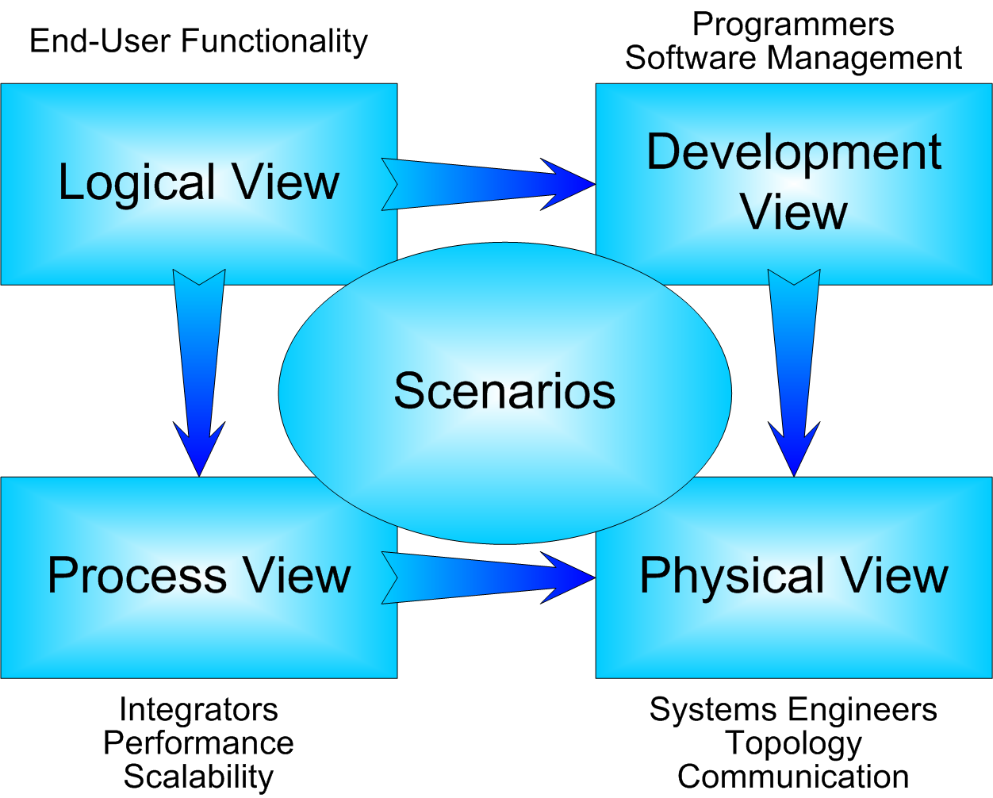
RUP – 4+1

Slide 82
RM-ODP Viewpoints (2001)
Manager
Enterprise
Business model
Database Modeler
Designers
Logical, data modeling
Logical view of services
Information
Computational
Operating Sys. Engineer
Developer
Servers, Comm,
Physical view of
data and services
(IDL, WSDL)
Engineering
Technology

Slide 83
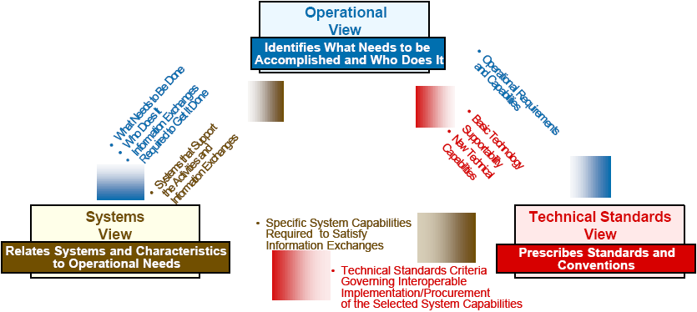
DODAF (3 Main Views)

Slide 84
Zachman Framework
Data
(What)
Function
(How)
Network
(Where)
People
(Who)
Time
(When)
Motivation
(Why)
Scope (Ballpark) view
Owners View (Enterprise Model)
Designers View (System Model)
Builder’s View (Technology Model)
Out of Context View (Detailed Model)
Operational View (Functioning)
Notes:
.

Slide 85
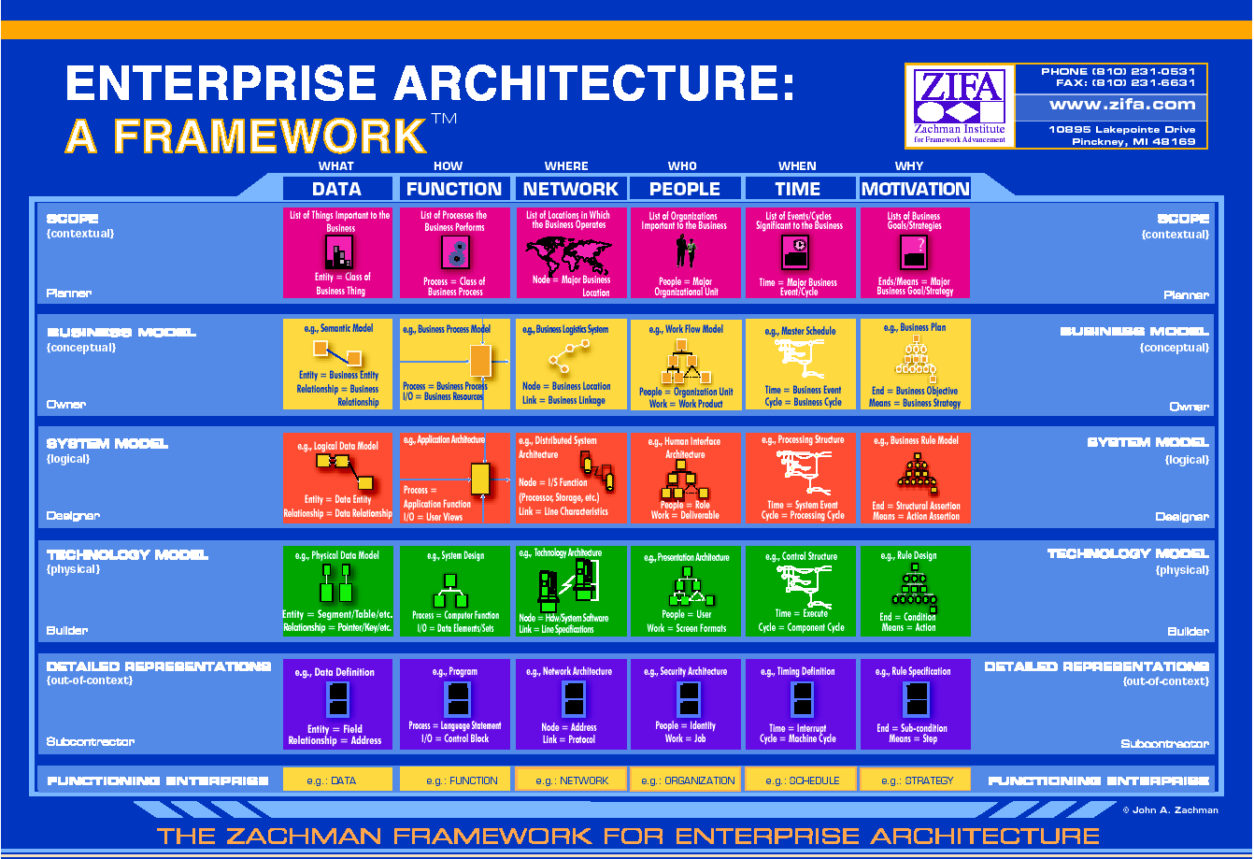
Notes:
.

Slide 86
Old Model
MSF 3.0 + Views
Aimed at business executives
Aimed at business process owners
Aimed at architects and designers
Aimed at designers and developers
Contextual
Conceptual
Logical
Physical
Notes:
.

Slide 87


Old Model
MSF 3.0 + Views
Business strategies & processes
Applications to facilitate business process
Information needed to manage business
Technology to support business & application needs
Contextual
Conceptual
Applications View
Information View
Technology View
Business View
Logical
Physical
Notes:
.

Slide 88
New Model set of views and artifacts -
Business
Capabilities
Technology
Architecture
Manual
Procedures
Reconciliation
Business Processes
and Entities
Constraints
Reconciliation
Services, Messages,
Applications, Endpoints
Logical
Data Center
Constraints
Abstraction/
Refinement
Abstraction/
Refinement
XML, Projects,
DBs, Classes, Code
Physical servers & segments
Deployment
Units
packaged into
deployed on
Notes:
.

Slide 89
Can be mapped…
Business
Applications
Information
Technology
Business
Capabilities
Technology
Architecture
Contextual
Manual
Procedures
Reconciliation
Conceptual
Business Processes
and Entities
Constraints
Reconciliation
Logical
Services, Messages,
Applications, Endpoints
Logical
Data Center
Constraints
Physical
Abstraction/
Refinement
Abstraction/
Refinement
XML, Projects,
DBs, Classes, Code
Physical servers & segments
Deployment
Units
packaged into
deployed on
Notes:
.

Slide 90
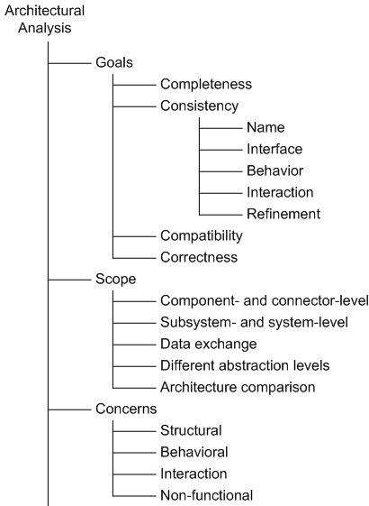
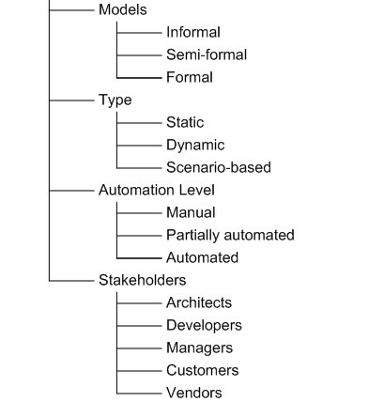
Architectural Analysis in a Nutshell
Software Architecture: Foundations, Theory, and Practice; Richard N. Taylor, Nenad Medvidovic, and Eric M. Dashofy; © 2008 John Wiley & Sons, Inc. Reprinted with permission.

